Slide 1

API for Control Tower
Abilasha Vediappan & Vikrant Kashyap

Slide 2



What is API
Application Programming Interface
An API is a software intermediary that allows two applications to talk to each other.
It specifies how different system interact with each other through set of protocols, routines and tools.
Database
API
Data lakes, Cloud
Notes:
This is an example of a Text Slide. Reference the different layout options in the Slide Master (under the View tab) for different variations. Remember, our new Brand Guidelines call for clean and simple messages and design. Reference the PowerPoint Guidelines on the Brand Book for tips and useful information on creating effective presentations.

Slide 3

Benefits of API
Flexible & Scalable
Time Efficient
Innovative
Easy Integration
Increases Productivity
Notes:
APIs help organizations become more flexible. They simplify design and administration and offer opportunities for innovation.

Slide 4
Benefits of API
Explanation for before slide
Flexible & Scalable : Api itself can be scaled up to many layers and levels
Time Efficient: both the setup of integration and the Api connection itself are less time consuming and easy to automate.
Easy Integration : system to system interaction in API makes its easy to integrate with any software or system
Increases productivity: Since API is automated and real time, it increases the productivity.
Innovative:

Slide 5
API in Control Tower
Value Add
In current control tower architecture ftp is used for file transfer which can be replaced by API interaction between Forwarders & Control Tower system.
In End to End Control tower API can play a major part of how different systems interact real time for timely update on order details.
With connection to data lakes like IDS through API Control Tower will be more streamlined and integrated.
Any more …..??

Slide 6
API in Control Tower
ftp vs API
 | ftp
 | FTP is used to transfer files between computers on a network
 | FTP is a batch that allows you and others, to login to it in order to transfer files back and forth. If you have larger files that cannot be sent through standard email, this is a useful service
 | File transfer through ftp at times is manual and it takes lot of effort between the parties to set up and upload and also to fetch and run
 | The files can be customized to the need with various information.
 | API
 | API is a set of routines, protocols, and tools for building software applications
 | API specifies how different Softwares should interact with each other, they are also used when programming different task components
 | One of the many benefits of having an API set up is that files are sent back at a quicker rate and with less chance of human error.
 | Data through API feed is limited and any addition of new fields or information involves complex process behind.

Slide 7
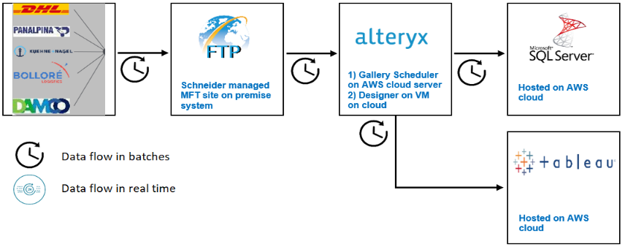
Transport control tower – as-is architecture
Data is manually pushed by forwarders at regular, scheduled times and so is the data processing actions in Alteryx
Notes:
This is an example of a Text Slide. Reference the different layout options in the Slide Master (under the View tab) for different variations. Remember, our new Brand Guidelines call for clean and simple messages and design. Reference the PowerPoint Guidelines on the Brand Book for tips and useful information on creating effective presentations.

Slide 8
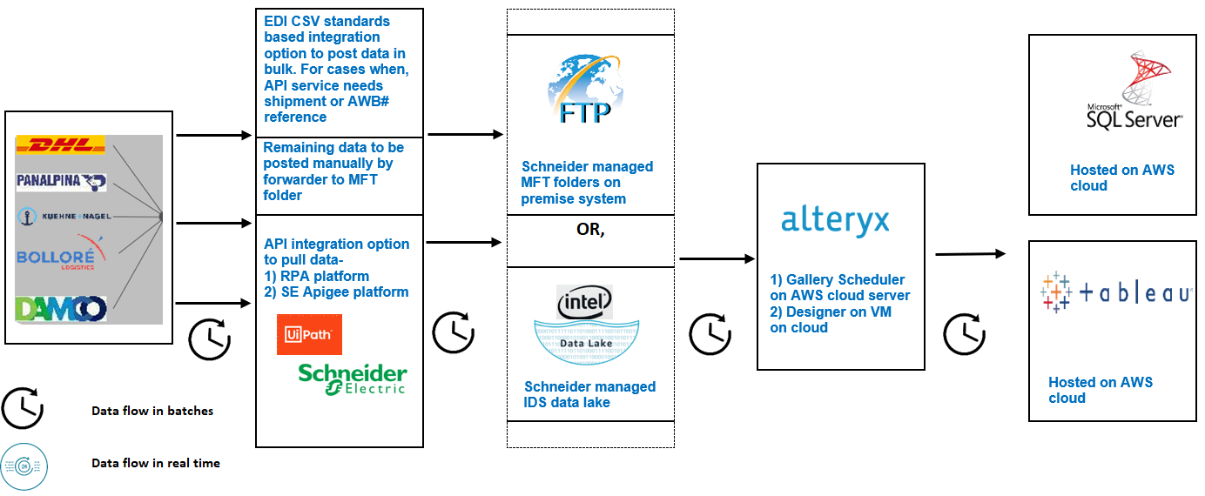
Transport control tower – to-be architecture
Data is pulled by RPA API or, Schneider hosted APIs, from forwarders API end points, at scheduled times. This polling mechanism to GET data, then transformed in required file format csv/excel
Notes:
This is an example of a Text Slide. Reference the different layout options in the Slide Master (under the View tab) for different variations. Remember, our new Brand Guidelines call for clean and simple messages and design. Reference the PowerPoint Guidelines on the Brand Book for tips and useful information on creating effective presentations.

Slide 9
Proposed integration options comparison
Topic | CSV post | API | EDI- CSV
Integration | Data push: forwarders manually create the CSV/ Excel files. SE TCT team also transforms some files manually | Data pull: SE API will talk directly with the forwarder’s system API | Data push: Communication is via a file feed. So, EDI data is stored at forwarder’s system, then transmitted
Real time | Only possible in batch mode | Real (near real) time support makes APIs the fastest, most seamless way to access data | Since data needs to be stored, there is some limitation to real-time visibility and responsiveness
When to use | Only for manual data that cannot be interfaced system to system | For track & trace/ milestone data that can be transferred in bulk | Where API is not able to query in bulk, EDI CSV option can be the alternative for track & trace/ milestones
Investment/ cost | As is process. No additional cost | API development/ hosting cost Support cost Manual effort for data not supported with API | None for solution development, as this should be on forwarders side Manual effort for data not supported with API
Benefit |  | Reduction in manual effort, at both Forwarders side and SE side Faster data transfer Can connect transport data to IDS for E2E CT | Reduction in manual effort, at both Forwarders side and SE side
Notes:
This is an example of a Text Slide. Reference the different layout options in the Slide Master (under the View tab) for different variations. Remember, our new Brand Guidelines call for clean and simple messages and design. Reference the PowerPoint Guidelines on the Brand Book for tips and useful information on creating effective presentations.

Slide 10
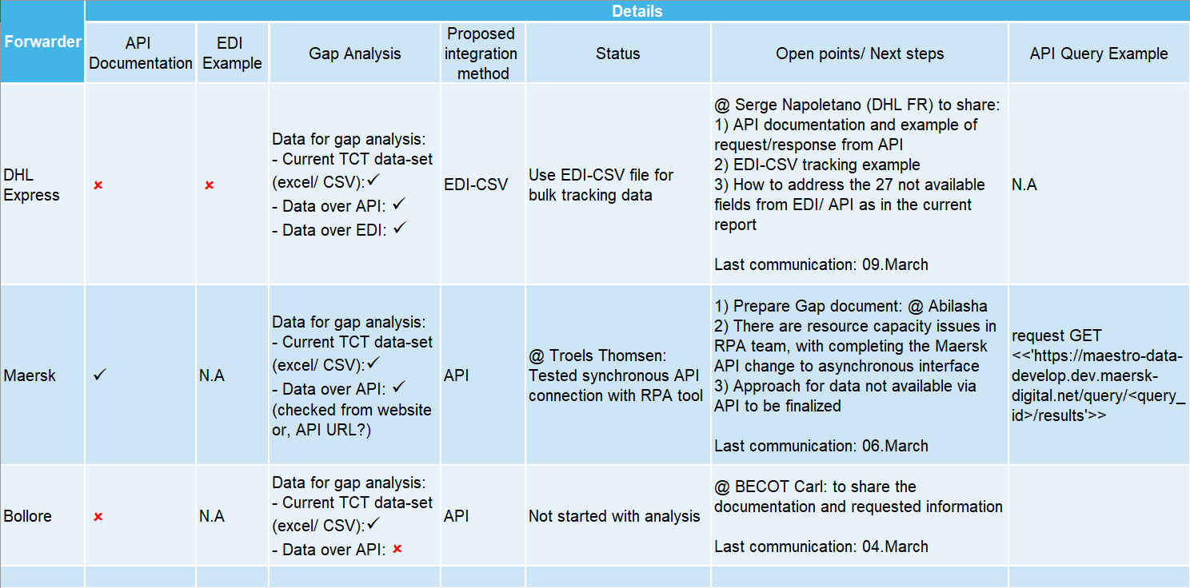
Status and Next steps
Notes:
This is an example of a Text Slide. Reference the different layout options in the Slide Master (under the View tab) for different variations. Remember, our new Brand Guidelines call for clean and simple messages and design. Reference the PowerPoint Guidelines on the Brand Book for tips and useful information on creating effective presentations.

Slide 11
Forwarder integration notes
Forwarder | Approach
DHL Express | 1) API web-services a) Supports SOAP/XML and REST/JSON protocols b) The API request needs to be sent from Schneider to DHL Express web-service end-point URL. And needs to contain: i. Waybill# (internal DHL reference) Or, ii. Shipment reference together with account# c) The API request will be one shipment at a time. A request just with account# is not possible. This limitation is due to their current API configuration setup and cannot be modified d) As of now, DHL Express API is available for use e) Missing data needs to be uploaded separately f) Going forward with API, will mean: - A Schneider platform that queries (ERP or some system?) for shipment reference. As there is no such shipment reference in TCT platform - Constructs the request message (XML/JSON) and posts to DHL Express API - Receives back the API response (XML/JSON) - Parses, transforms the response and posts it to SQL server/FTP site from where Alteryx can pull the data 2) EDI-CSV connection a) EDI triggered CSV file can be pushed for account#. So, bulk tracking data can be supported b) CSV files can be posted to Schneider MFT site. Frequency and check-point at which the file is shared can be setup c) Since there are lot of Schneider accounts in DHL Express (>300), EDI-CSV tracking will need ~ 1 week to be ready d) Missing data needs to be uploaded separately - EDI standard spec does not allow new/custom fields to be mapped e) Going forward with EDI-CSV, will mean: i. DHL Express generates and sends the CSV file to Schneider MFT site ii. The frequency of posting data and required milestones can be configured on DHL Express side iii. Alteryx workflows connect to data 3) Manual CSV upload a) Missing data needs to be uploaded separately, with lesser frequency
Notes:
This is an example of a Text Slide. Reference the different layout options in the Slide Master (under the View tab) for different variations. Remember, our new Brand Guidelines call for clean and simple messages and design. Reference the PowerPoint Guidelines on the Brand Book for tips and useful information on creating effective presentations.

Slide 12
Forwarder integration notes
Forwarder | Approach
Maersk | 1) API web-services a) Supports SOAP/XML and REST/JSON protocols b) As of now, Maersk API is available for use c) Connection using RPA API (UiPATH) is tested for Synchronous calls. This has limitation of only 100 rows. Changing from Synchronous to Asynchronous is still in progress d) The API request needs to be sent from Schneider to Maersk web-service end-point URL. And needs to contain: i. At regular times during the day, Schneider sends an Asynchronous request to Maersk API that will immediately return with a query_id that is a hexadecimal string ii. With the query ID, Schneider needs to submit a GET request to Maersk API iii. Maersk API will return the data-set e) With the RPA tool, the output can be given in Excel/CSV, through BOT to target database- SQL server etc; Also, the POST method to data lake should be supported f) There are some RPA resource capacity issues with completing the Maersk API change – currently, there are 7 members in UiPATH RPA team, but for API only 1 person is available (Bhanu) 2) Manual CSV upload a) Missing data needs to be uploaded separately, with lesser frequency
Notes:
This is an example of a Text Slide. Reference the different layout options in the Slide Master (under the View tab) for different variations. Remember, our new Brand Guidelines call for clean and simple messages and design. Reference the PowerPoint Guidelines on the Brand Book for tips and useful information on creating effective presentations.

Slide 13
Forwarder integration notes
Forwarder | Approach
Bollore | 1) API web-services Need information from forwarder (API details – connection options/ data options etc.) to begin analysis 2) Manual CSV upload a) Missing data needs to be uploaded separately, with lesser frequency
Notes:
This is an example of a Text Slide. Reference the different layout options in the Slide Master (under the View tab) for different variations. Remember, our new Brand Guidelines call for clean and simple messages and design. Reference the PowerPoint Guidelines on the Brand Book for tips and useful information on creating effective presentations.

Slide 14
Project Team

Slide 15
Project Timeline

Slide 16
Notes:
Closing slide

